Slide 1

CAR PRICE PREDICTION
Submitted by:- OJASAV SAHU
Internship :- 23

Slide 2
Table of contents:
Introduction
Analytical problem framing
Analysis
Visualization
Training and testing the data
Conclusion and Limitation and Scope for the future:

Slide 3
Introduction:
With the covid 19 impact in the market, we have seen lot of changes in the car market. Now some cars are in demand hence making them costly and some are not in demand hence cheaper.
The market value is based on a number of factors, including demand, supply, options, and incentives. The market value of a vehicle usually falls somewhere between the sticker price and the invoice price. Because the market value is an average, some people will pay more than that amount, while others will pay less.
A car's value is determined by many factors: the popularity of the make and model of your car, vehicle specifications, trim levels, physical appearance, mileage, consistent maintenance and working condition. Using this as a base, I have collected the data from cars24 websites. The data was collected for the different car bodies.
Once the data is collected, the data will be cleaned and pre-processed with all the necessary tools and the same will be used to build machine learning models in order to predict the price of the same.

Slide 4
Analytical Problem Framing:
The dataset has around 7039 rows and 14 columns. Using this dataset, we will be training the Machine Learning models on 70% of the data and the models will be tested on 30% data.
Since we have removed the null values from the dataset during the data collection stage, we can expect outliers and un-realistic values for certain variables.

Slide 5
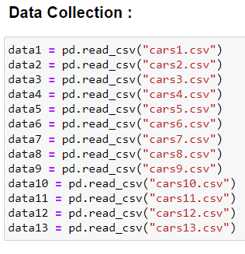
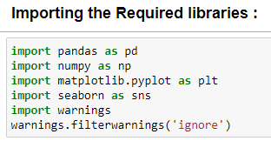
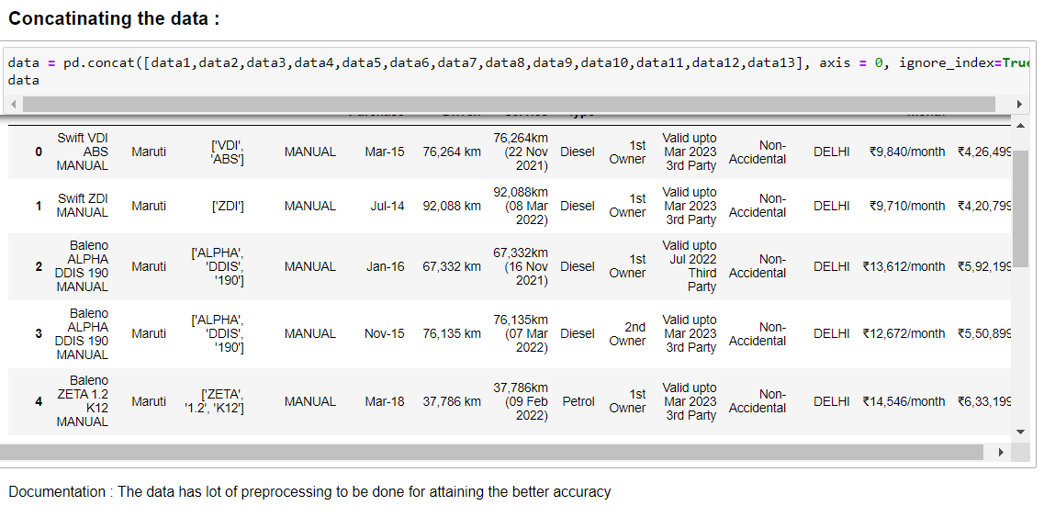
Analysis:
Here I have imported the libraries necessary and then I have collected the data and then concatenated the data and framed it into a dataframe using “Pandas”.

Slide 6
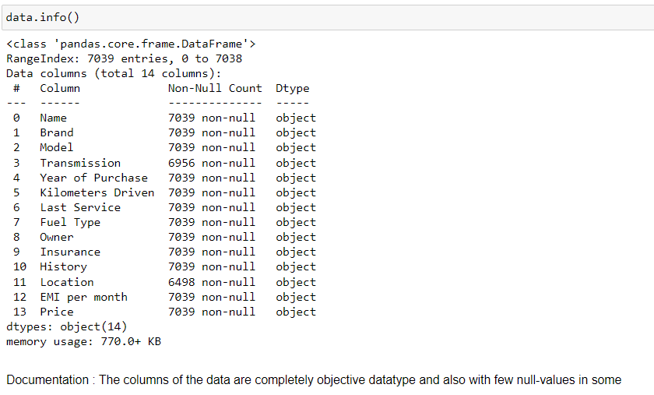
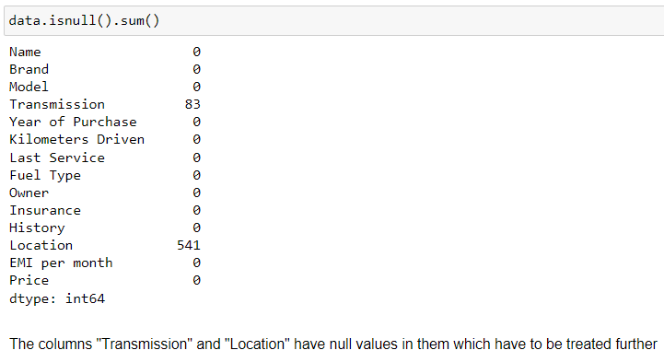
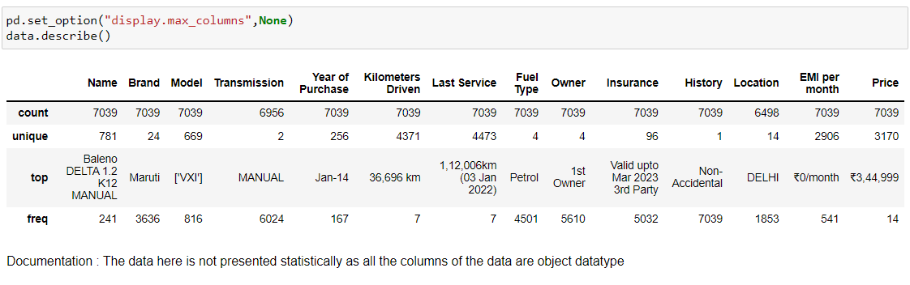
Here I have information of the data where I found that the data has Object data type and also there are two columns which have null values in them.
I have taken the description of the data in which I got the unique values and frequency of the data present in the feature as the features are object type data I couldn't get the statistical description of the data

Slide 7
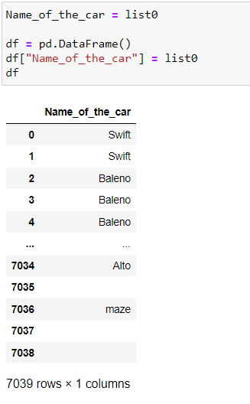
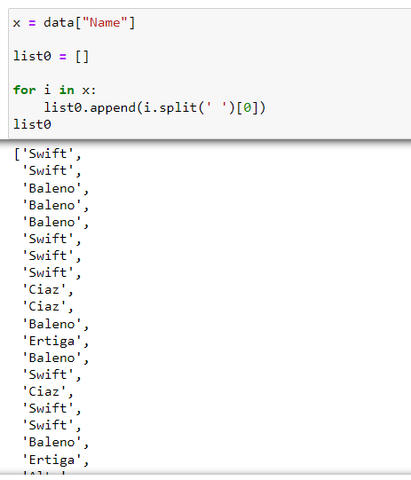
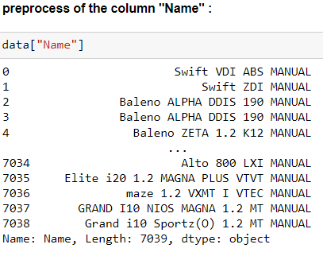
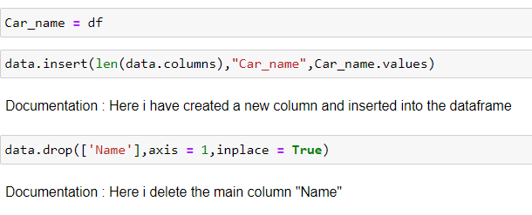
pre-processing :
Here I will present the preprocessing of few of the features:
Here I have extracted the required data from the column and inserted into the dataframe.

Slide 8
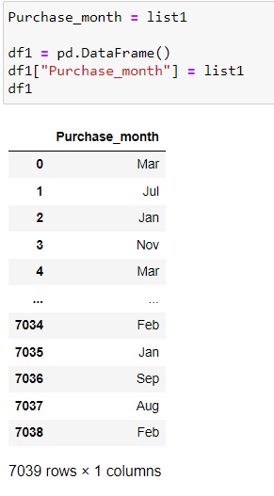
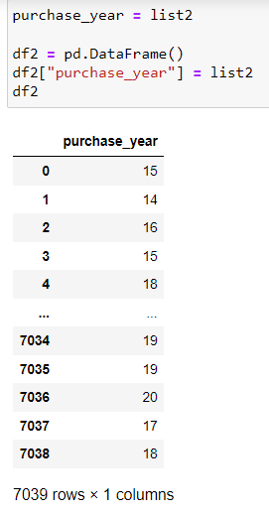
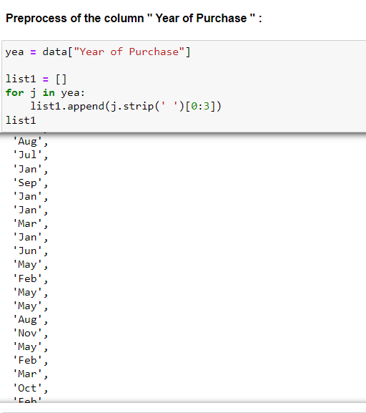
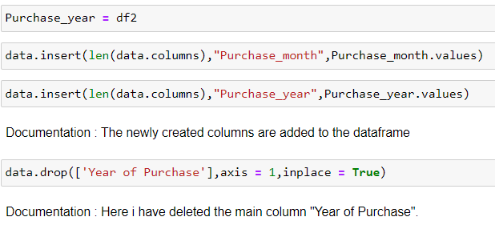
Here I have extracted the data within two new columns and then inserted them into the dataframe.

Slide 9
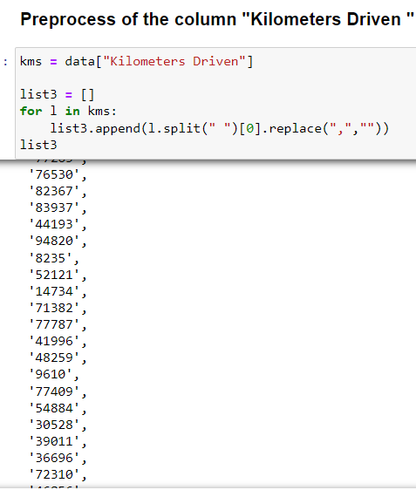
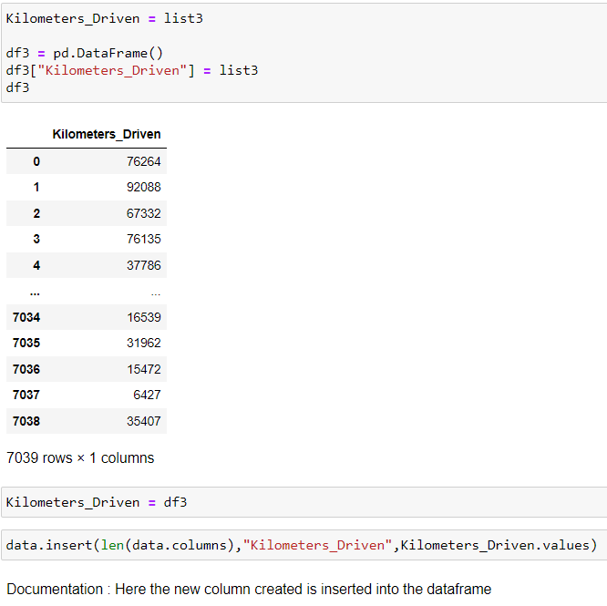

Here I have extracted the required information from the column “kilometres Driven” and instead created another column with same name ” kilometers_Driven”.

Slide 10
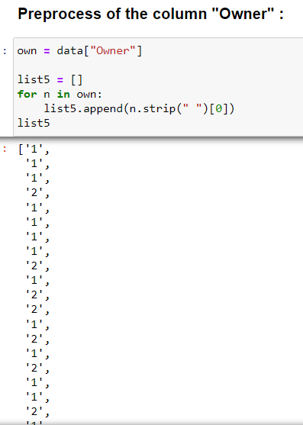
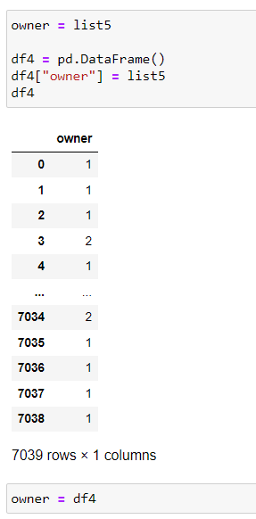
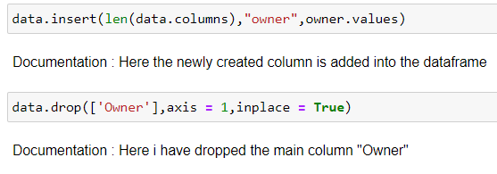
Here I have created a column with same name “owner” but with the required data and the dropped the main column “Owner”.

Slide 11
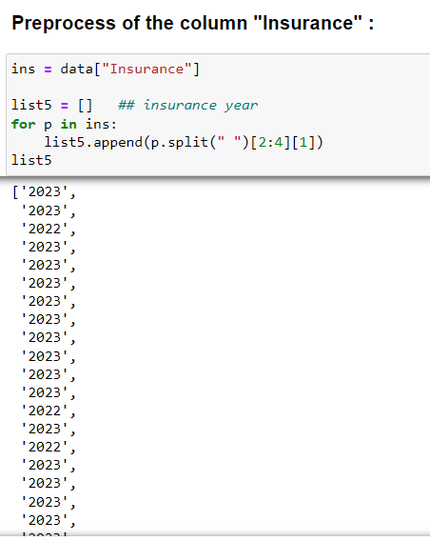
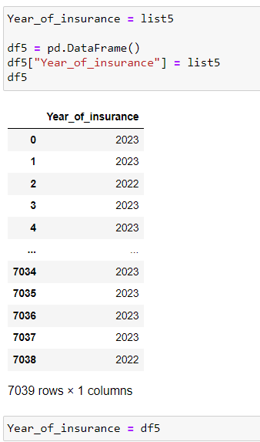
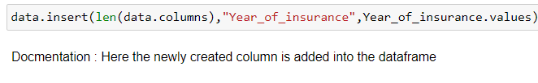
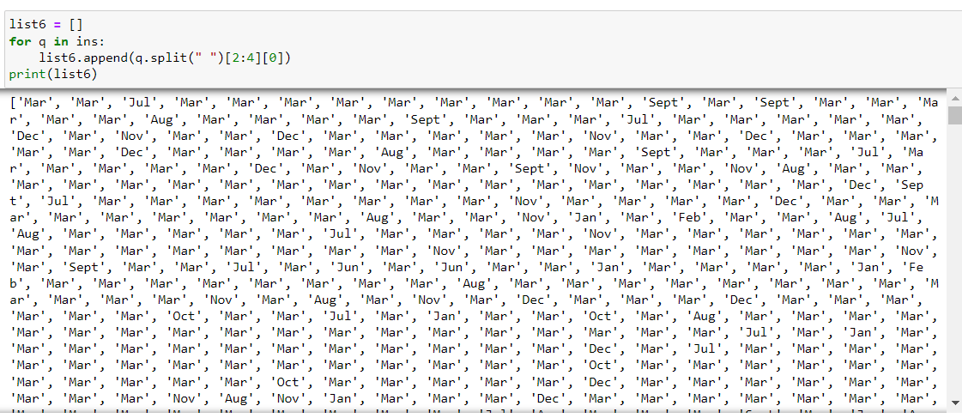
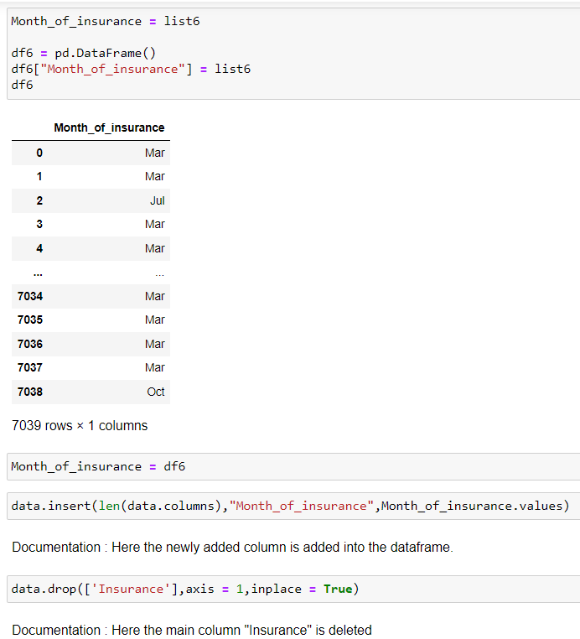
Here I have extracted 2 columns named “Year of insurance” and “Month of insurance” from the main column “insurance” and I have dropped that column.

Slide 12
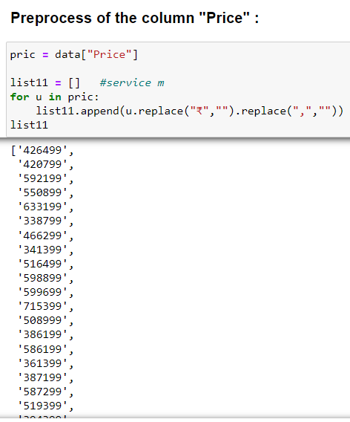
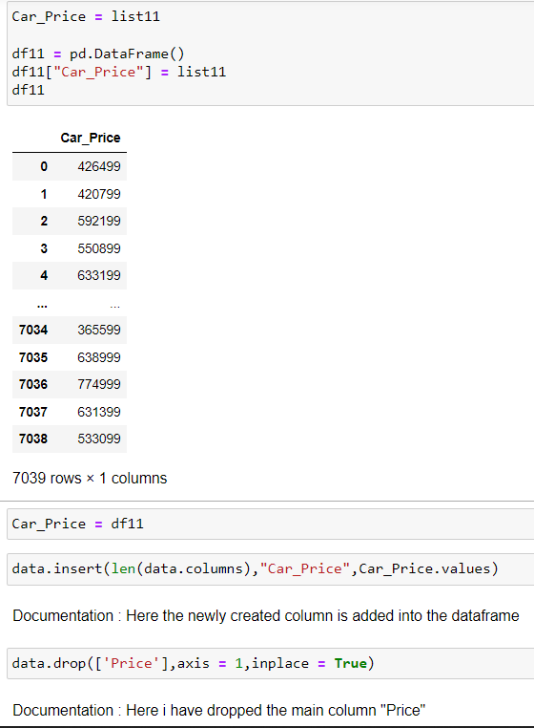
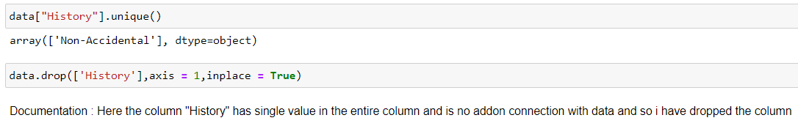
Here I have extracted the required data from our label column “Price” and created a new column named “Car_Price” and I have dropped the main column.
Here I am dropping the unnecessary column “History” in which all the values of the data are same and also do not have any impact on the data.

Slide 13
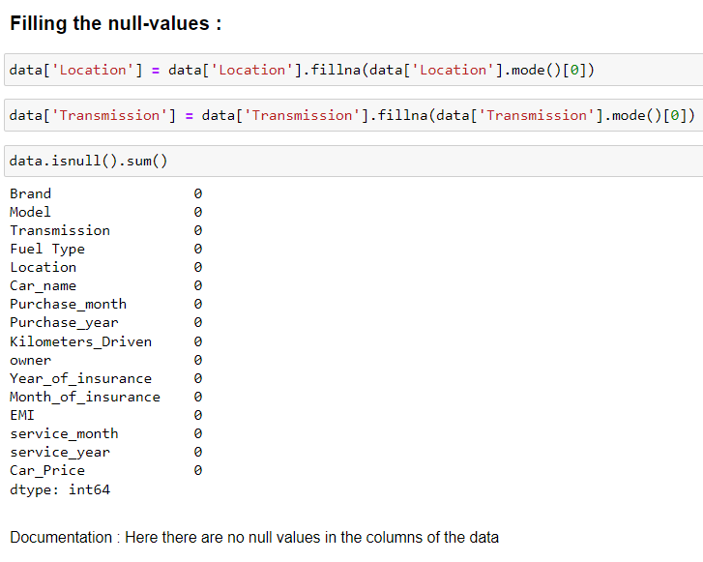
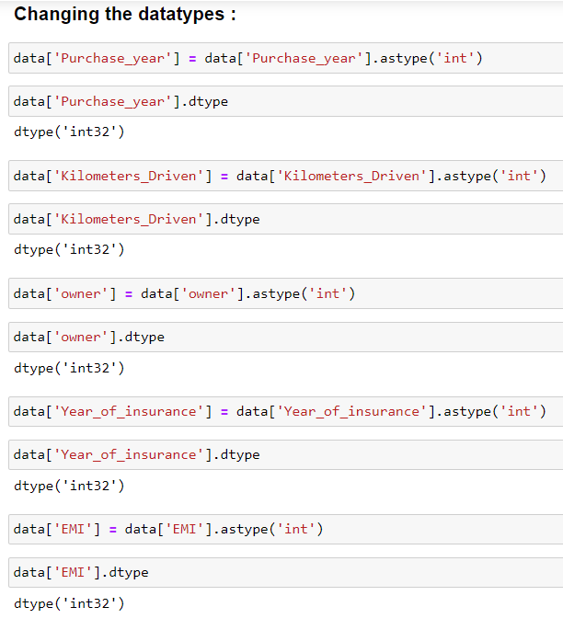
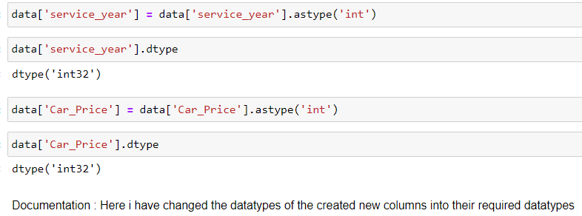
Here I have filled the columns with null values and again I have checked the null values data which is “0” now in all the columns which means that I have successfully filled the null values in the columns necessary.
The newly created columns have the same datatype and so I have changed their datatypes as required for better model building.

Slide 14
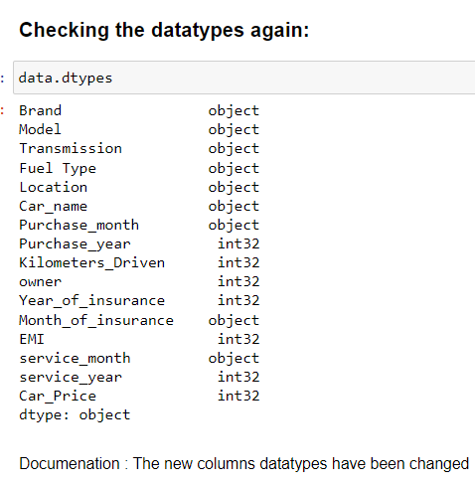
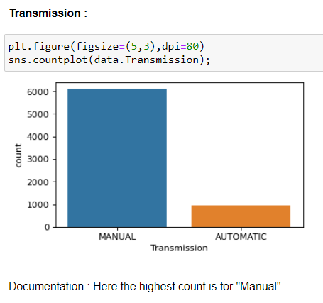
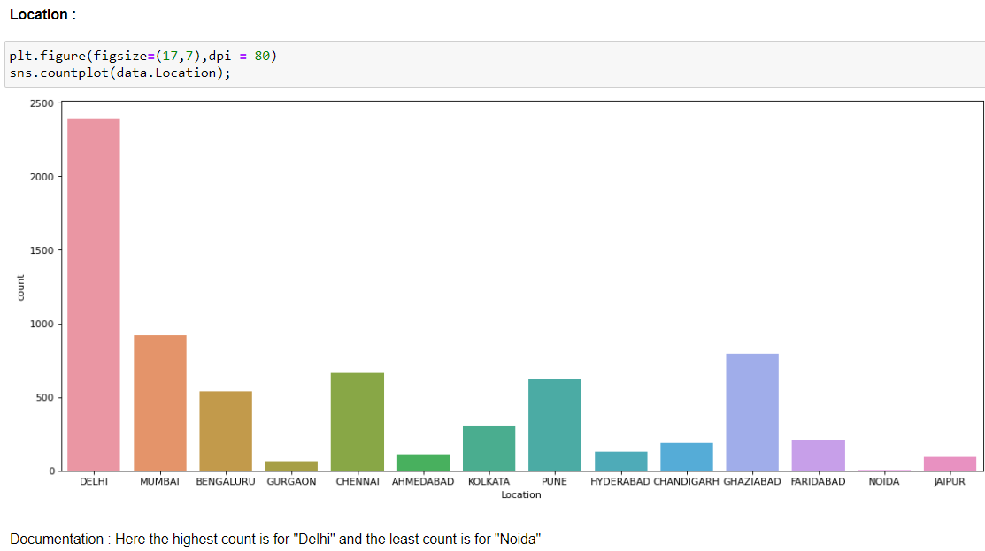
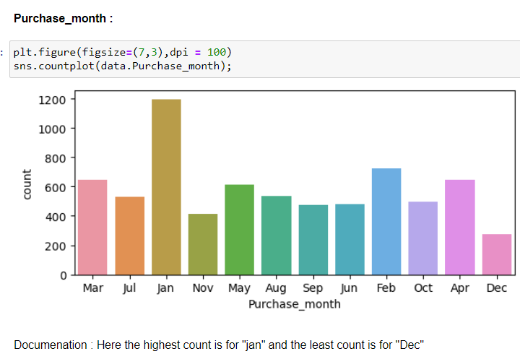
Here the columns which have been preprocessed have converted into their appropriate datatypes.
Visualization :

Slide 15
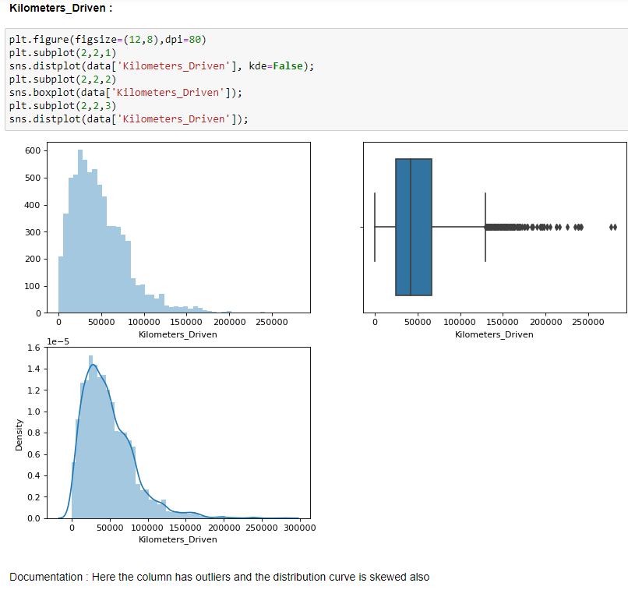
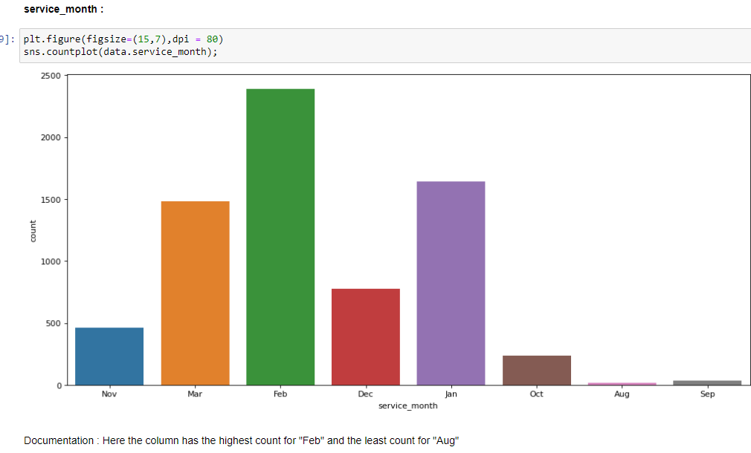
The above presented are few features with univariate analysis.

Slide 16
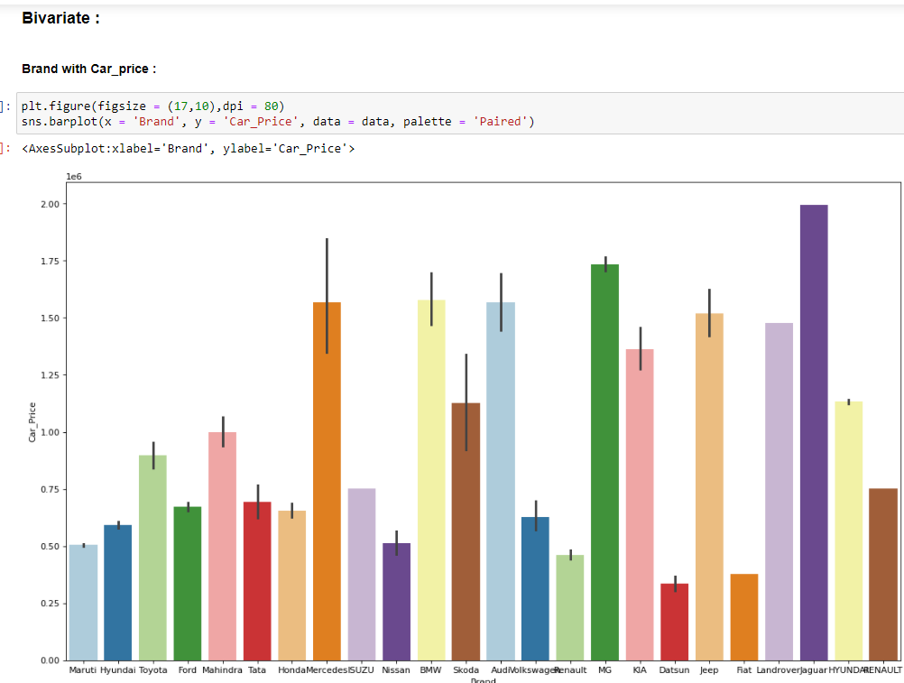
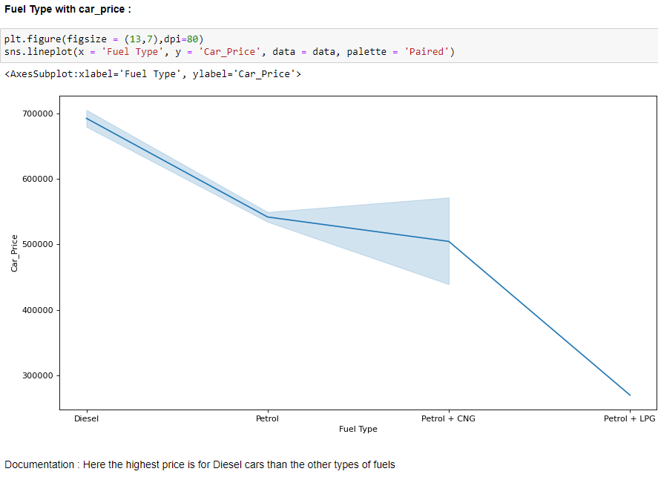

Slide 17
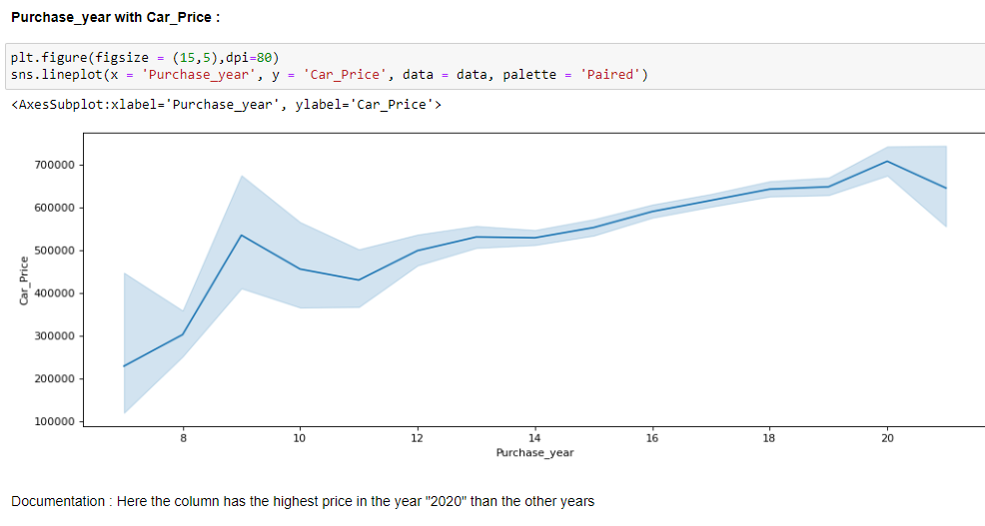
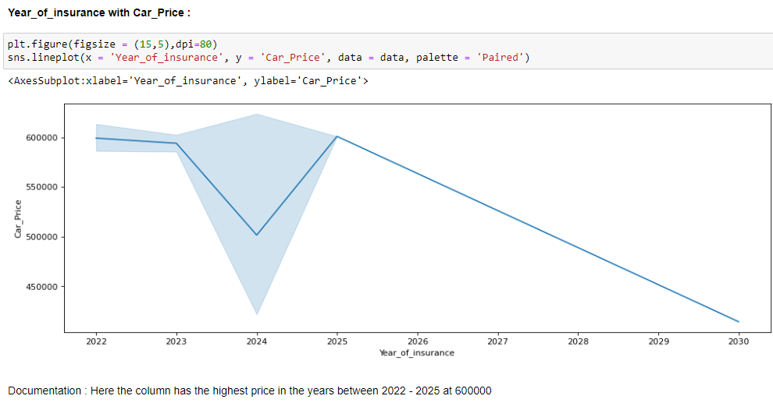
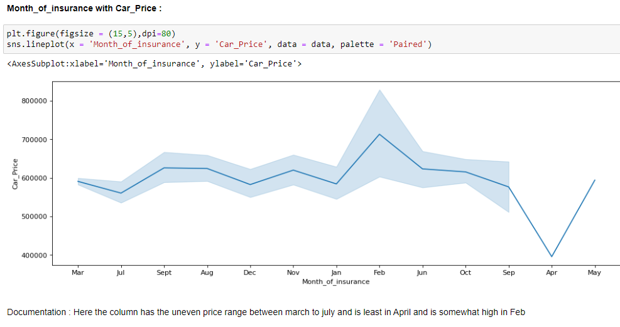

Slide 18
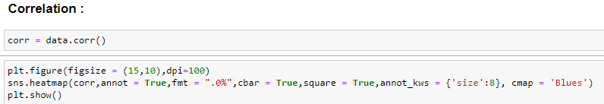
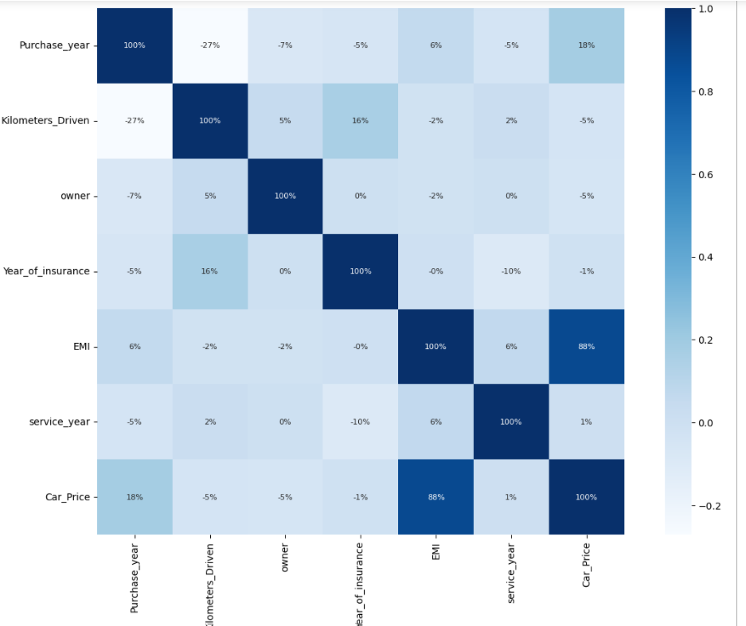
Correlation of the features with the label:
Here the highest correlated column is the column "EMI" for our label column "Car_Price”.

Slide 19
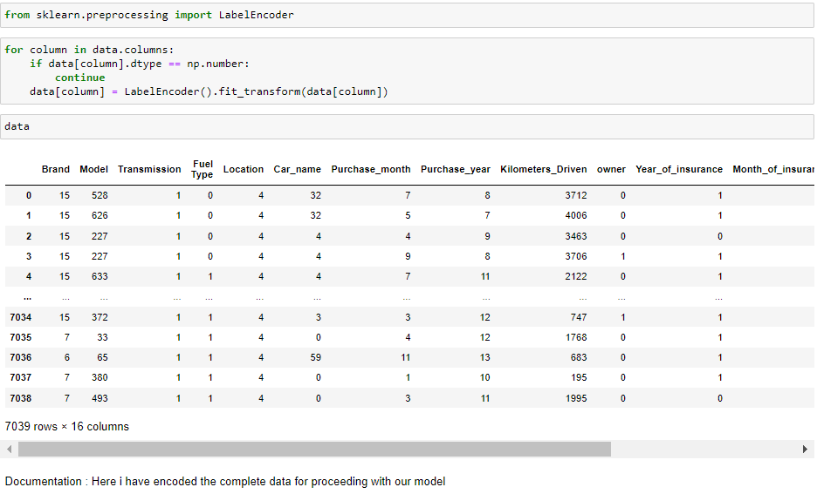
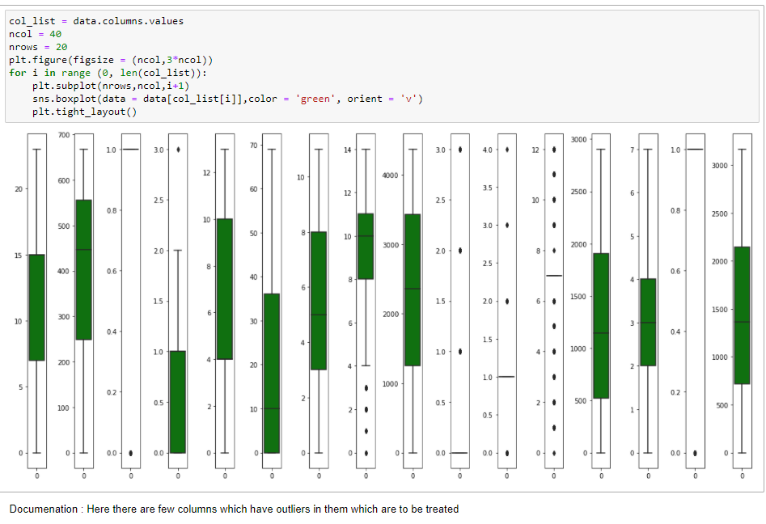
Now, here we encode the data present in our dataset for further model building through Label Encoder:
Now, we will check for the outliers present in the data:

Slide 20
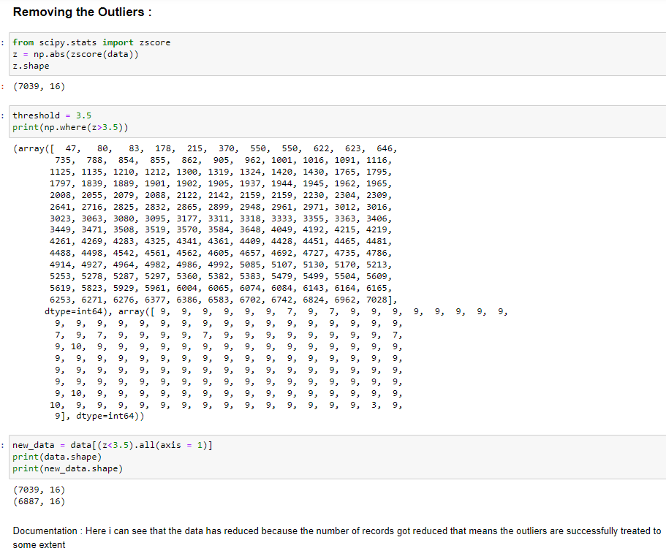
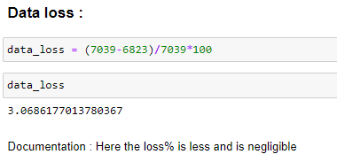
We will be Removing the outliers through Z-Score method:
Here I have data loss of 3.06% which is negligible and I can continue with the model building.

Slide 21
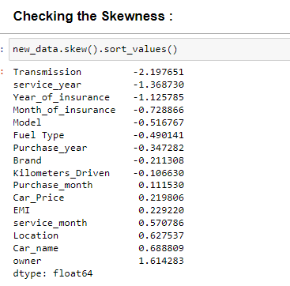
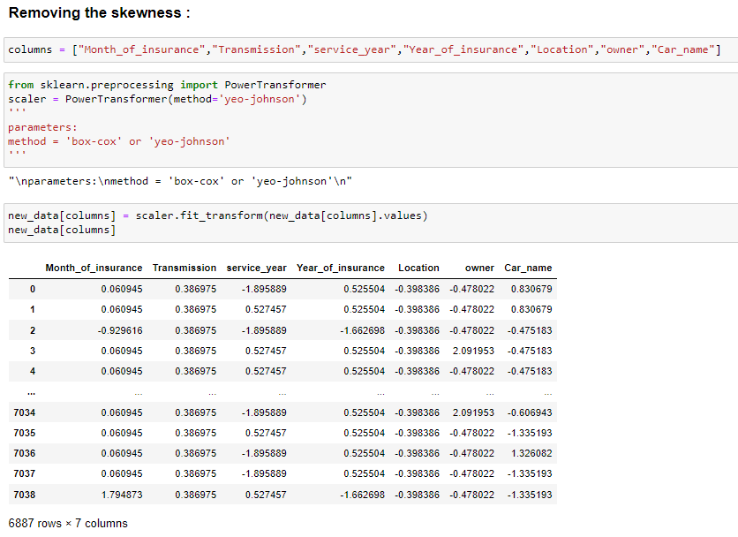
Now, here I am going to check the skewness of the data:
Here the number of columns with negative skewness is more than positive skewness columns and which have to be treated
Now, here we will remove the skewness of the data through “Power Transformer”
Here, I have assigned few columns which have skewness to a variable and passed it through the “Scaler.fit_transform” method to reduce the skewness of the data.

Slide 22
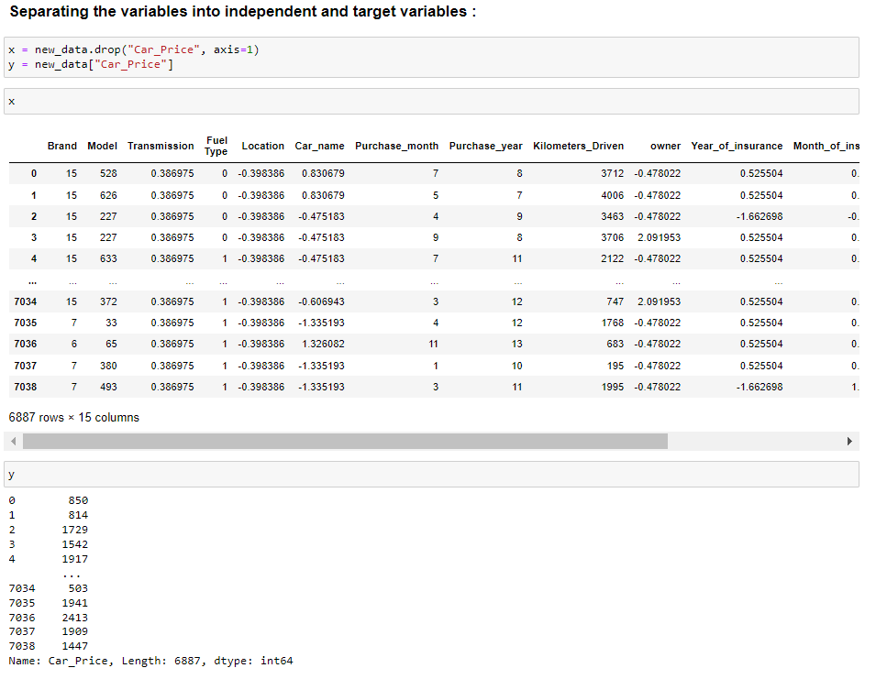

Now, the next step is Scaling the data through Standard Scaler:
Here I have splitted the data into x and y and then passed “x” into the Standard Scaler and here the data is scaled.

Slide 23

Now, here I import few libraries required for training the model and testing and also for checking the random_state:
Here I have splitted the data with the resulted random_state.

Slide 24


Training and Testing of the data:
Now, I will test the data and find accuracy of the data with different models:

Slide 25


Now, here I will check the Cross Validation Scores of the models tested:cvx
Here the “Random Forest model” has the highest Cross Validation Score

Slide 26


Now, I am going to Save the model and also print the Predicted and Original values of our data:

Slide 27
CONCLUSION:
I have successfully built my model using multiple algorithms and found that the Random Forest Regressor model is the best model.
As i can see from the boxplot, I couldn’t remove all the outliers but since the data is expensive, I have to proceed with the dataset with outliers.
LIMITATIONS AND SCOPE FOR THE FUTURE:
Here the model had more outliers even after treating them and also skewness was also present in few features but we had to proceed and also I was not sure that whether the model can be built well completely after turning into a new dataset.
During the data collection I have faced a problem which is few websites, pages do not provide proper information or mixed information which creates problem while building the model

Slide 28


